Slide 1
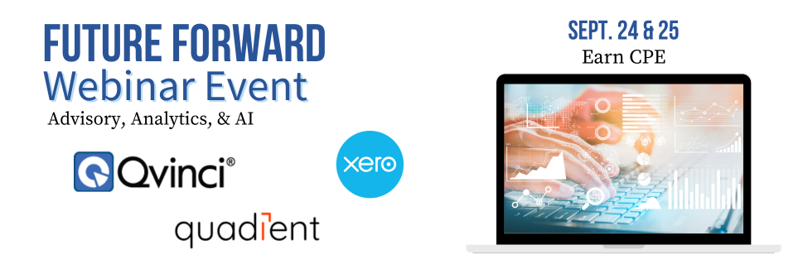
“Scoring Your Best” (In the ProAdvisor Awards)

Slide 2
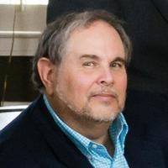
Today’s Speaker
William (Bill) “Murph” Murphy
Today’s webinar is being led by William ‘Bill’ Murphy, better know as ‘Murph’ to the ProAdvisor and accounting community. Murph, has been around long enough to see ‘compact discs emerge from the primordial pond’ to become Intuit’s first offering Quicken, which then evolved into QuickBooks.
Murph is an Advanced Certified ProAdvisor and one of the founding members of Insightful Accountant. In other words, he has been consulting and writing about QuickBooks since the “dawn of time.”
Today, Murph is mostly retired from active QuickBooks consulting, but he still serves as Insightful Accountant’s Senior Technical Contributing Editor writing from 5 to 9 articles per week. He is also serves as Insightful Accountant’s ProAdvisor Awards Administrator.
Future Forward 2024

Slide 3
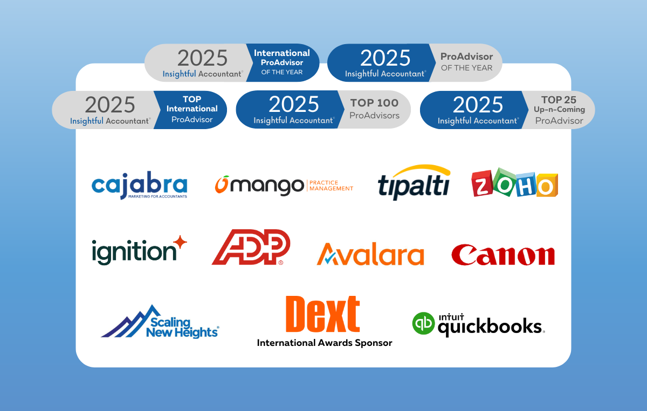
Future Forward 2024
Notes:
Thanks to the 2025 Top ProAdvisor Awards’ Sponsors… without these sponsors the awards wouldn’t be possible.

Slide 4
Single Objective based Agenda
This session isn’t qualified for CPE, but our objective is to help you understand how the ProAdvisor Awards are organized and how ProAdvisors are objectively evaluated, and key factors in ‘scoring your best’ when you complete your formal application for the awards.
We will look at the most common weaknesses identified in our 10+ years of measuring ProAdvisor performance, and also why many ProAdvisors have difficulty in reporting ‘who they really are’ within the application form.
We guarantee you will leave the webinar with valuable tips you can use to improve your score by perhaps ‘hundreds of points.’
Future Forward 2024

Slide 5
Future Forward 2024
Notes:
Let’s look at how you can crack the code of the Awards with a few behind the scenes secrets,

Slide 6
2025 U.S. ProAdvisor Awards
ProAdvisor of the Year
QB Online Educator Niche CAS Social QB Desktop
(10) (10) (10) (10)
QBO Adv Apps QBD QBES I.S.
(25) (5) (5) (15) (5) (5)
Payroll/HR Tax
Future Forward 2024

Slide 7
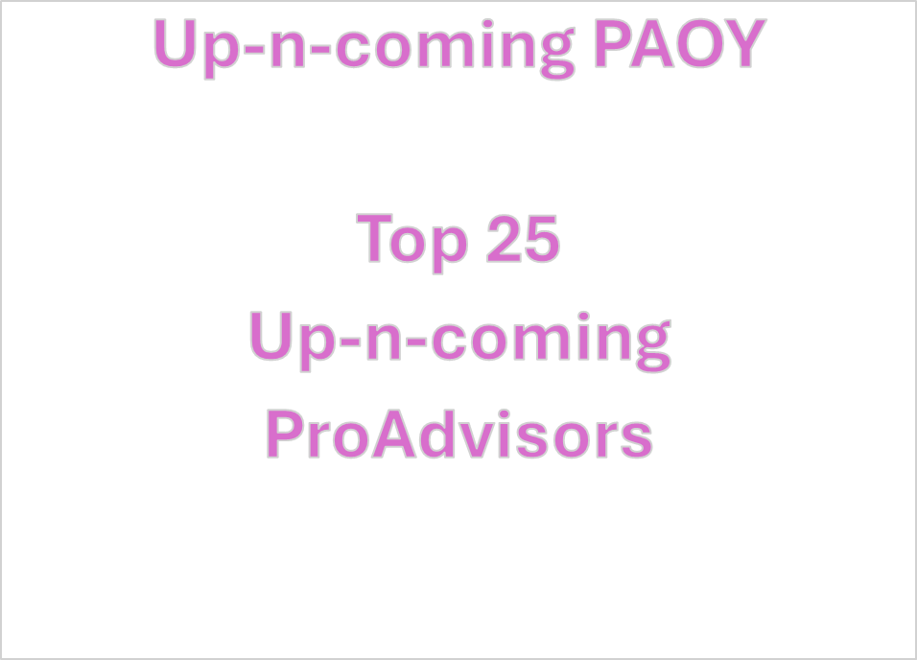
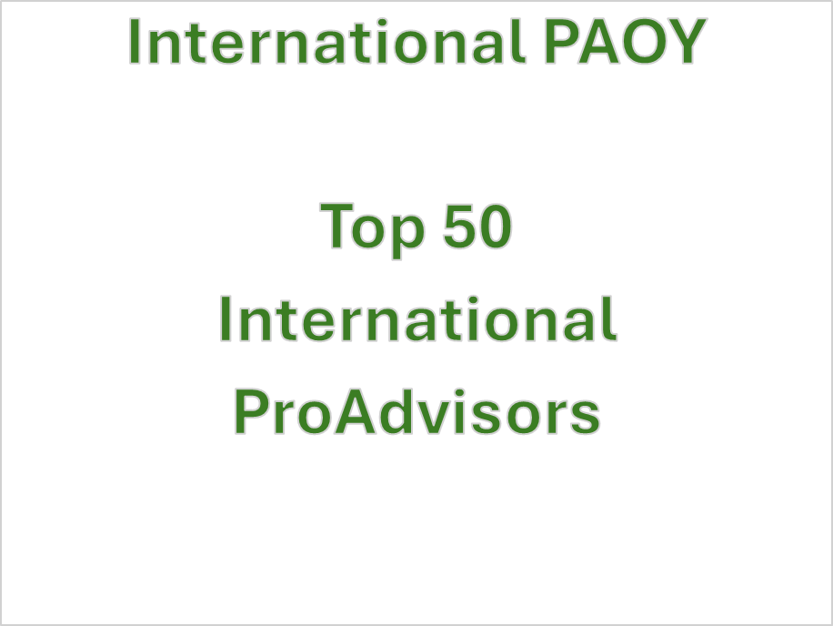
2025 ProAdvisor Awards
Future Forward 2024

Slide 8
2025 ProAdvisor Awards
Professional Stature – Education, Prof Credentials and Participation
Practice Performance – Know Your clients, your clients and your clients
Training – take all you can find, train and write on what you learn
Certifications – “Earn a wide-range of Certifications”
Ecosystem Engagement – Become an expert in ‘one’ or MORE products
“Be sure to count, track and report on everything you do during the year”… CPEs are great, but so are hours for things that don’t generate CPEs. Find the place(s) to report ‘it all’ in your application form… we can’t count it if you don’t tell us about it!!!
Future Forward 2024

Slide 9
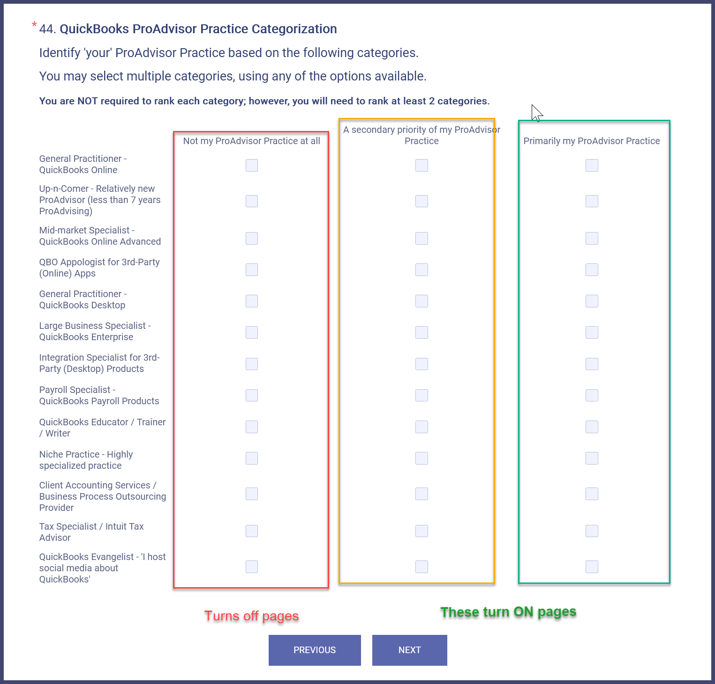
What ‘category’ of ProAdvisor Are YOU?
General Practioner
in QBO or QBD?
How about the ‘big
boys’: QBO-Advanced
or QBD-Enterprise?
Solution integrator:
QBO Apps or
QBD 3P Products?
Are you a ‘newbie’:
Up-n-Comer is for 7
years or less as QBPA
Do you specialize:
Have a Niche?
Payroll & HR?
Tax Prep & Consult?
Do you have a CAAS –
Business Outsourcing
Practice with/without
Specialization?
You might be an QB
Educator and not even
know it?
Is Social Media ‘Your
Thang’?
Future Forward 2024
Notes:
Knowing how the awards work, and where, and how you fit into the Awards process is key to expanding your award possibilities, while at the same time focusing the details on the one or two awards where you excel.

Slide 10
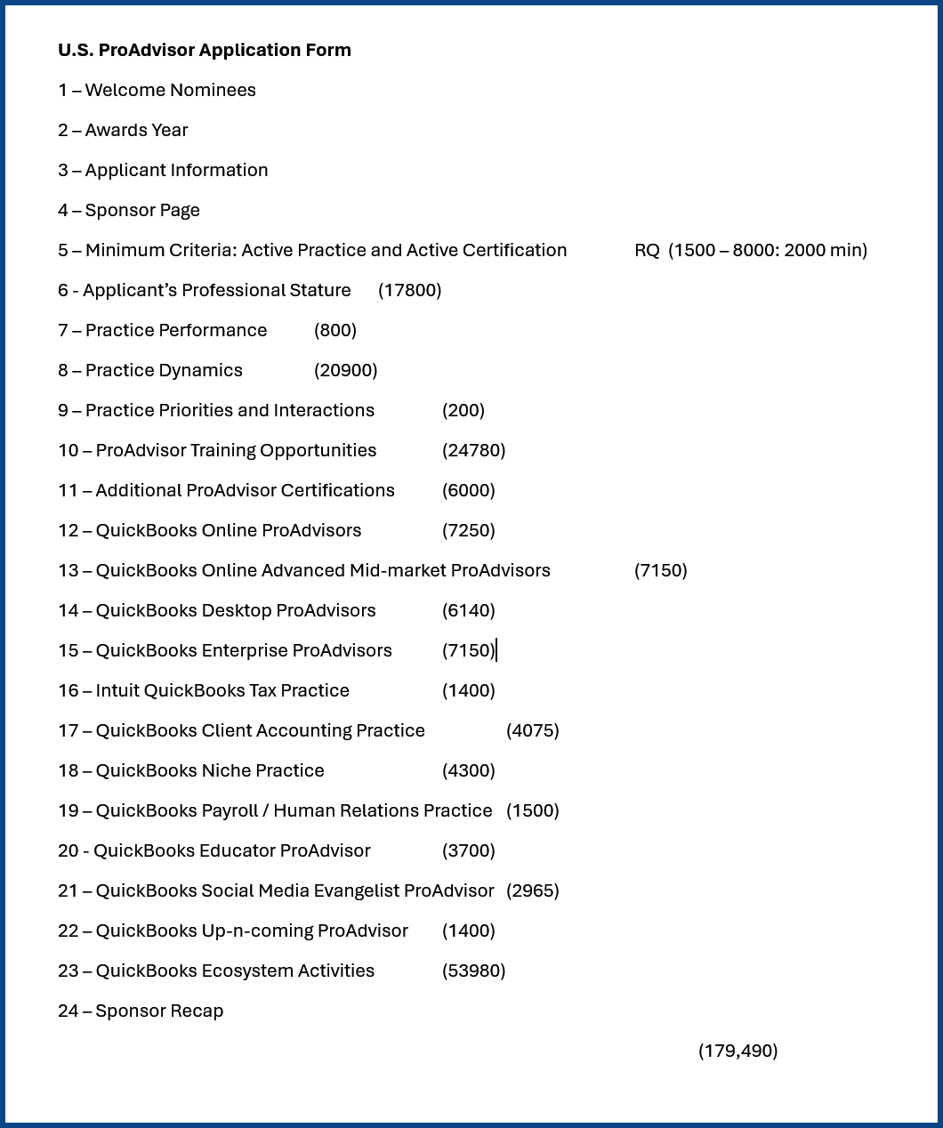
Where Do the Points Come From?
General Practioner
in QBO or QBD?
How about the ‘big
boys’: QBO-Advanced
or QBD-Enterprise?
Solution integrator:
QBO Apps or
QBD 3P Products?
Are you a ‘newbie’:
Up-n-Comer is for 7
years or less as QBPA
Do you specialize:
Have a Niche?
Payroll & HR?
Tax Prep & Consult?
Do you have a CAAS –
Business Outsourcing
Practice with/without
Specialization?
You might be an QB
Educator and not even
know it?
Is Social Media ‘Your
Thang’?
Future Forward 2024
Notes:
Because a majority of the pages in the application produce points, the ability to turn on those pages even if you only earn a 10% of the total points possible on a page could raise your score by at least 150 points and as much as 5398 points. That’s right just earning 10% of the points you might otherwise miss might raise you score by hundreds and possibly thousands of points.
But I must point out, the QuickBooks Ecosystem Activities page with all the Apps listed, or which you can also ‘type in’ this year, can earn you tens-of-thousands of points. That one page has the possibility of scoring nearly 1/3rd of the total points available. So absolutely DO NOT SKIP it.

Slide 11
Examples of Related Questions
Educator – Client Education
Educator - Public Speaking:
Notes:
I bet you never considered yourself a QuickBooks Educator before… but if you don’t turn on that classification, you don’t get to do either of these two things that can earn you hundreds of points….. ‘educating your clients’ and ‘speaking in public’.

Slide 12
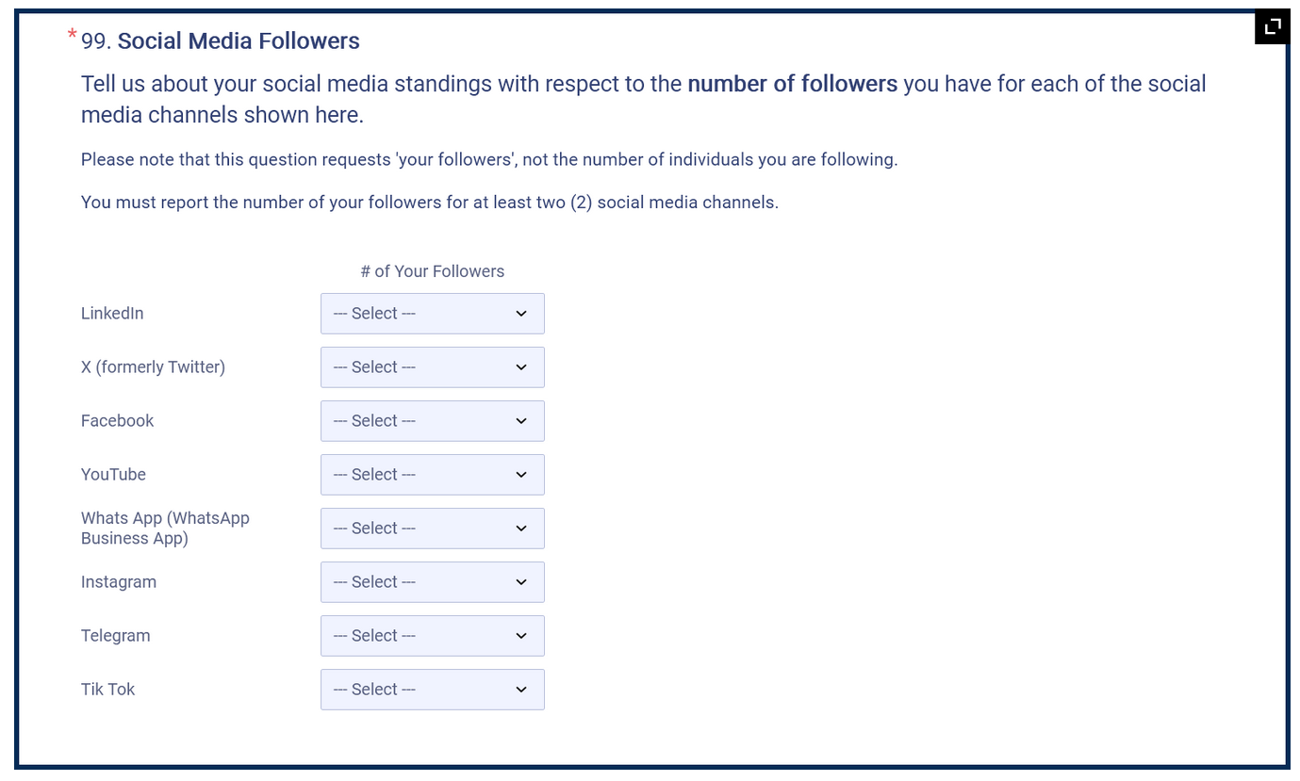
Examples of Related Questions
Social Media - Preferences
Notes:
If you don’t classify yourself under ‘Social Medica’ you don’t get to report how may followers you have for each ‘major’ social media channel. .

Slide 13
Examples of Related Questions
Niche Specialization – Payroll/HR Sub-specialty
You had better (1) classify yourself as PR/HR, you better (2) report using QB Payroll products, you better (3) have QuickBooks Payroll Certification, and you better be ready to (4) specify the relative percentage of your work is Payroll vs HR
Then be ready to answer additional PR or HR questions.
Notes:
If you don’t classify yourself under ‘Social Medica’ you don’t get to report how may followers you have for each ‘major’ social media channel. .

Slide 14
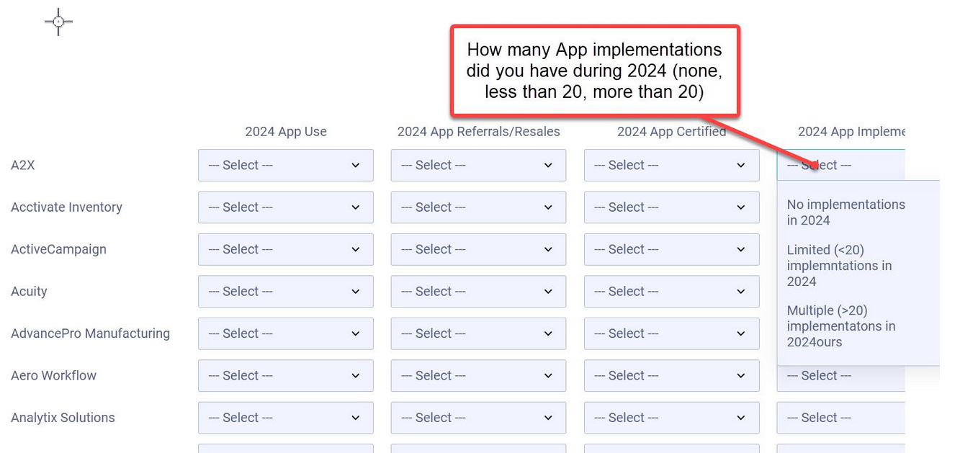
Examples of Related Questions
App focused practice
Tell us how ‘you’ and ‘your firm’ use the App
Tell us about your App referrals or resales.
If and when you were certified in the App
Notes:
If you don’t classify yourself under ‘Social Medica’ you don’t get to report how may followers you have for each ‘major’ social media channel. .

Slide 15
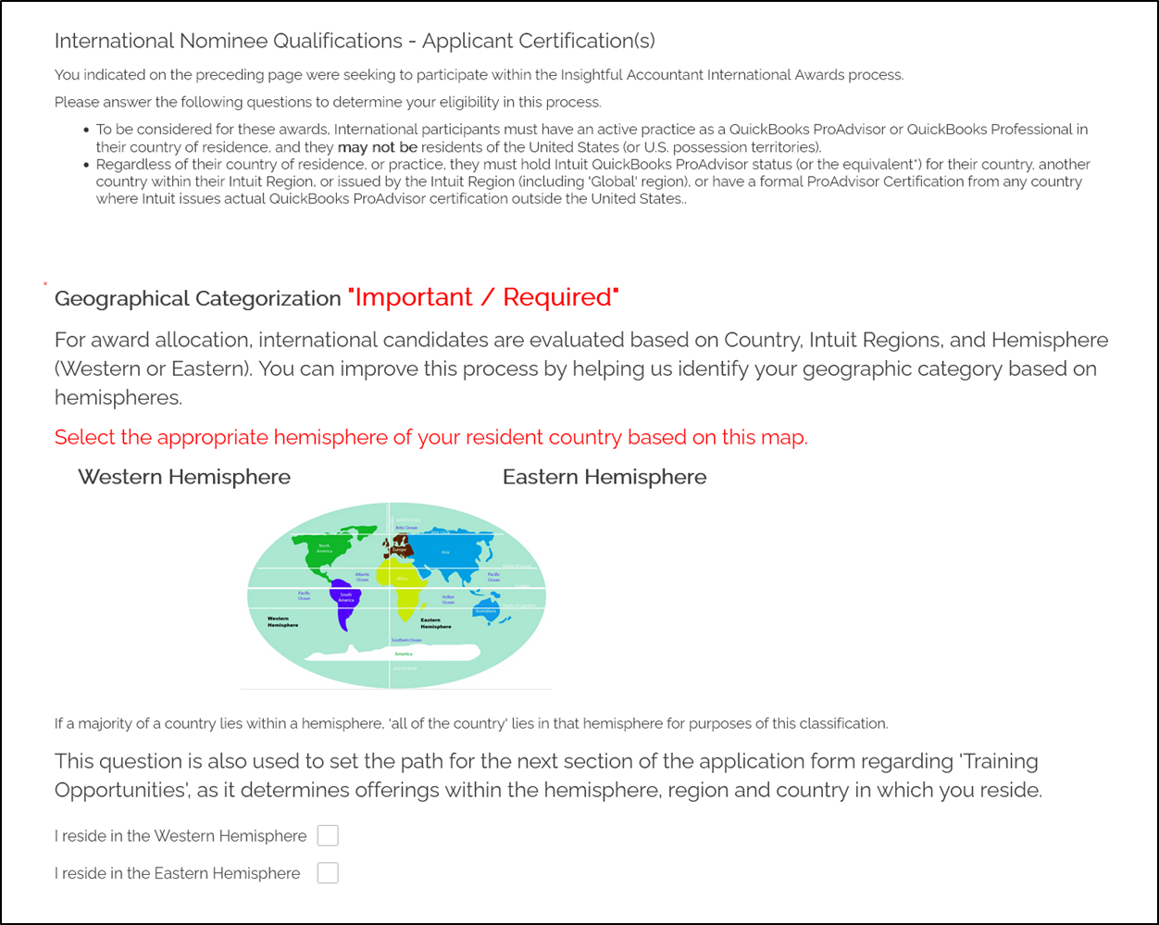
For Our International Participants: What Hemisphere Are You In?
Future Forward 2024
Notes:
The more participants from your hemisphere, the better. We weight the Qualified and Ranked Participants by the total number of international participants from each hemisphere.
For example, if we have 1000 total participants for the International Awards, and 60% are from the Eastern Hemisphere and 40% are from the Western Hemisphere, and there are 300 qualified and ranked candidates.
The top 30 of the 300 that are from the Eastern Hemisphere will be included in the list, and the top 20 of the 300 from the Western Hemisphere will be included in the list.
So the more ‘qualified’ ProAdvisors you nominate or solicit to apply who go through the application process, the more ProAdvisors from your hemisphere that will end up in the Top 50 International list.
There is one caveat to this… neither hemisphere will be represented by less than a total of 20 ProAdvisors in the list of 50 unless the number of qualified and ranked ProAdvisors from that hemisphere is less than 20. This is because prior to the Top 50, there were a minimum of 20 International ProAdvisors included in the Top 100.

Slide 16
Future Forward 2024
Notes:
Every Tuesday is ‘Top ProAdvisor Tuesday’ Keep looking for more ‘Tips’ on how to ‘score high’ within your categories.

Slide 17
Future Forward 2024
Notes:
Thanks to the 2025 Top ProAdvisor Awards’ Sponsors… without these sponsors the awards wouldn’t be possible.

Slide 18
That’s All Folks…
Thanks for Attending Today’s Webinar
Portions of this webinar were recorded for replay; you will receive information about accessing the recording of this webinar following the completion of today’s event.
A PDF version of today’s webinar will also be made available to participants.
Please give our staff a couple of days to make the information available to you.
See you next time.
Future Forward 2024

